Slide 1

Variables and Expressions

Slide 2
Today’s questions
How do computers conduct tasks we ask for?
How do computers store information (data) using code?
Once we store that information, how do we use it?

Slide 3
Today’s topics
Welcome to Python
Input, output, process
Variables Assignment and retrieval Types
Using variables In expressions

Slide 4
Welcome to Python

Slide 5
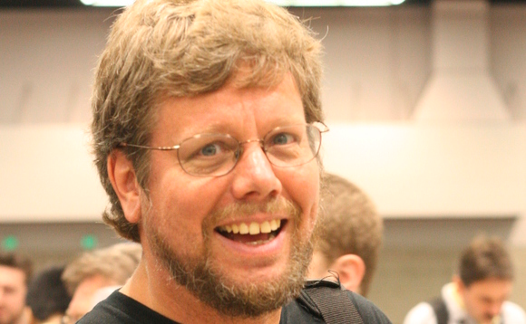

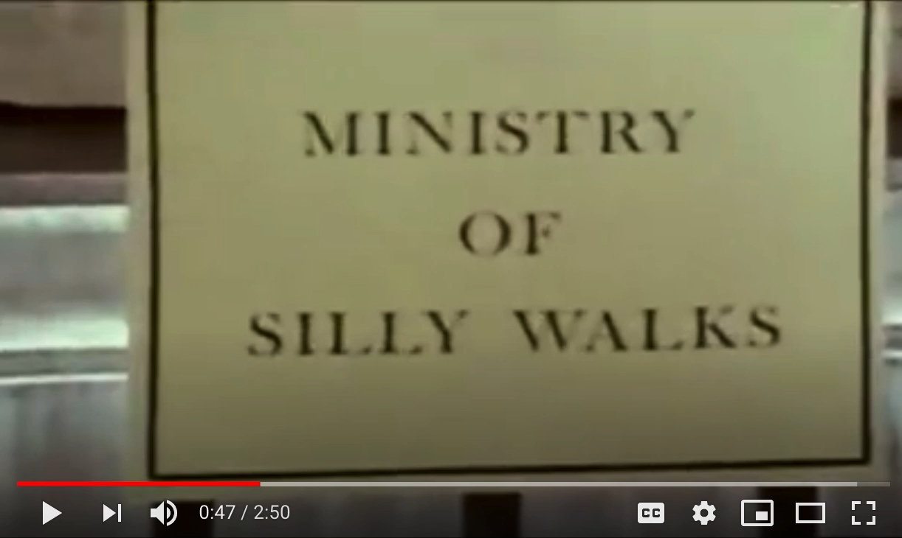
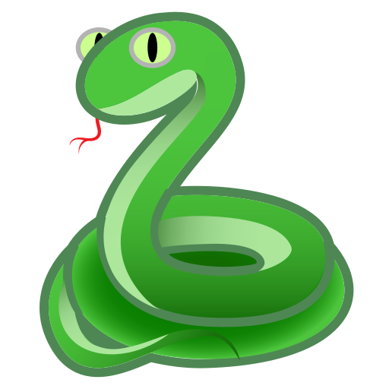
Welcome to Python
Guido van Rossum
(Creator of Python)

Slide 6
Using Python
Python must be installed and configured prior to use
One of the items installed is the Python interpreter
Python interpreter can be used in two modes:
Interactive mode: enter statements on keyboard
Script mode: save statements in Python script

Slide 7
Interactive Mode in Python
When you start Python in interactive mode, you will see a prompt
Indicates the interpreter is waiting for a Python statement to be typed
Prompt reappears after previous statement is executed
Error message displayed If you incorrectly type a statement
Good way to learn new parts of Python

Slide 8
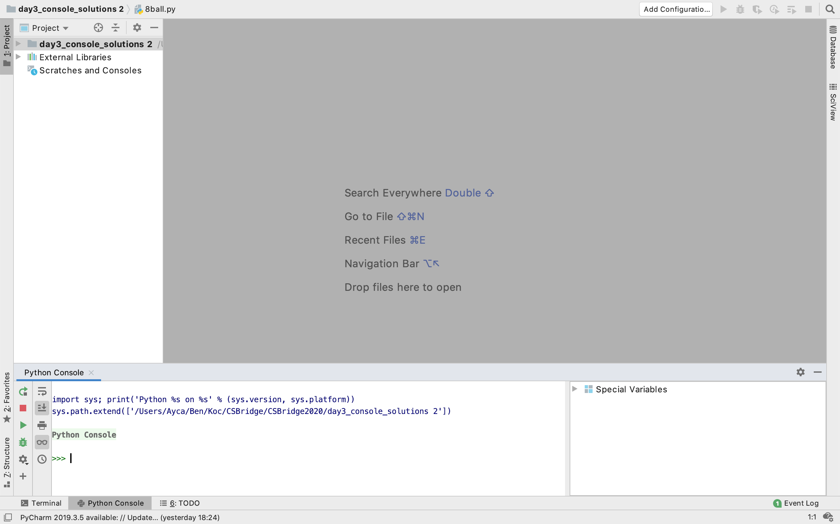
Interactive Mode in Python

Slide 9
Writing and Running in Script Mode
Statements entered in interactive mode are not saved as a program
To have a program use script mode
Save a set of Python statements in a file
The filename should have the .py extension
To run the file, or script, type
python filename
at the operating system command line

Slide 10
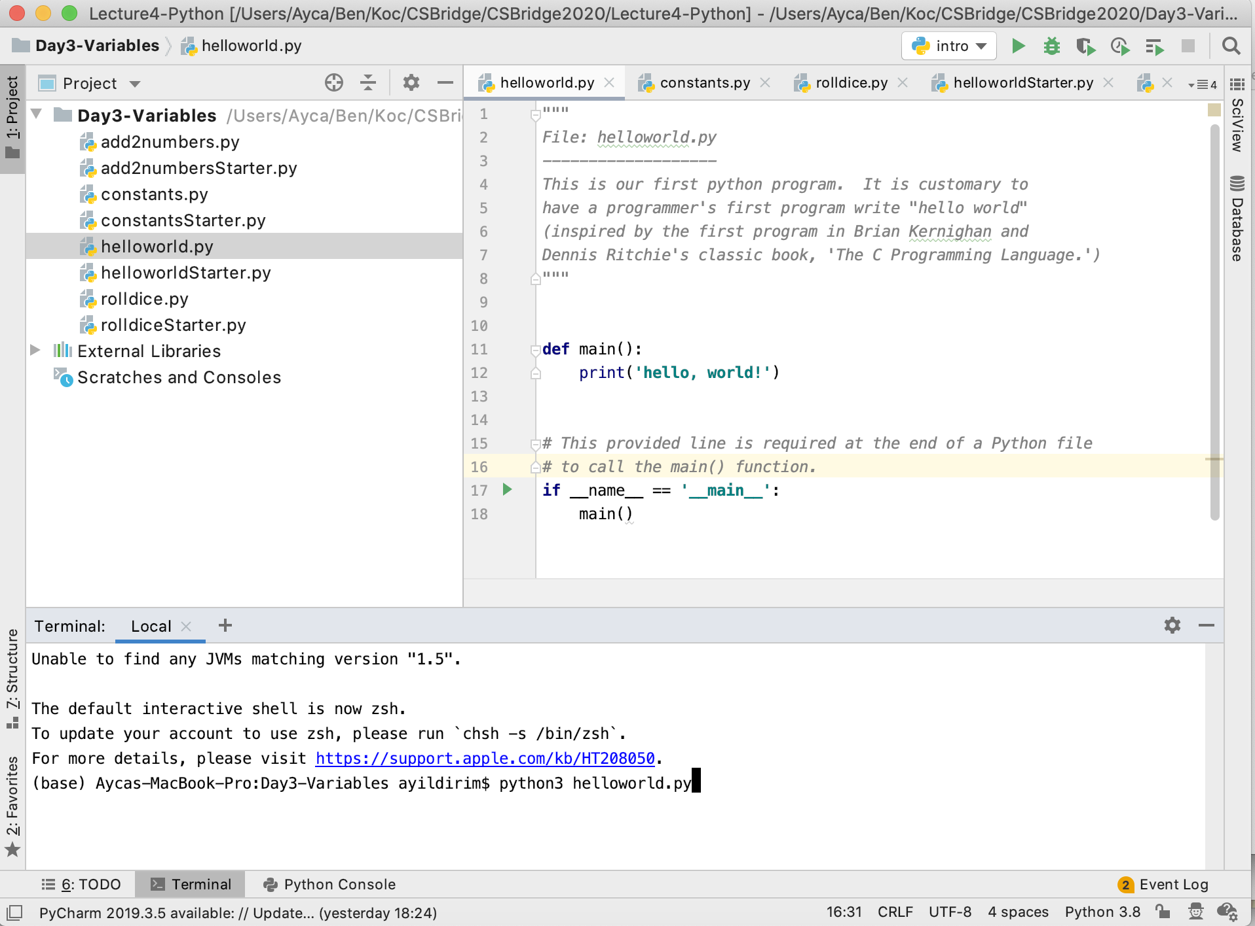
Writing and Running in Script Mode

Slide 11
How do computer program typically consists of?

Slide 12
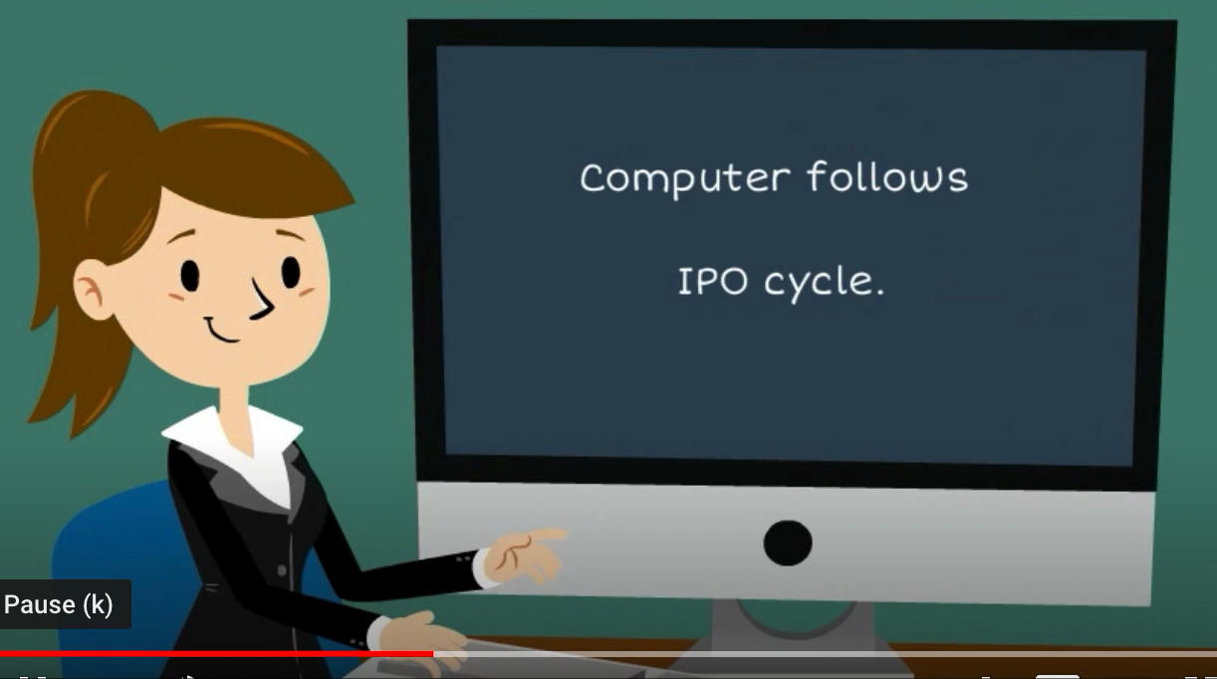
Input, Process, Output

Slide 13
Input, Processing and Output
Typically, computer performs three-step process
Receive input
Input: any data that the program receives while it is running
Perform some process on the input
Example: mathematical calculation
Produce output

Slide 14
How do computers output?

Slide 15
print function
print("This program adds two numbers.")
print command prints text to the terminal
Text printed is between double quotes ("text")
Can also be between single quotes ('text')
Choice of quotes depends on text you are printing
Double quotes when text contains single quotes
print("no, you didn't") ➔ no, you didn't
Single quotes when text contains double quotes
print('say "hi" Karel') ➔ say "hi" Karel

Slide 16
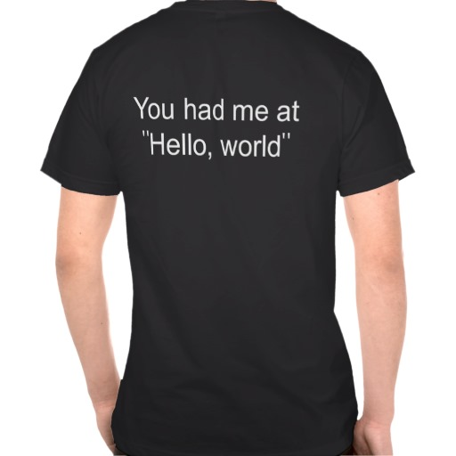
Our first program

Slide 17
Our First Python Program
""" File: helloworld.py ------------------- This is our first python program. It is customary to have a programmer's first program write "hello world" (inspired by the first program in Brian Kernighan and Dennis Ritchie's classic book, 'The C Programming Language.') """
def main(): print("hello, world!") # This provided line is required at the end of a Python
# file to call the main() function. if __name__ == '__main__': main() # little bit different than in Karel

Slide 18
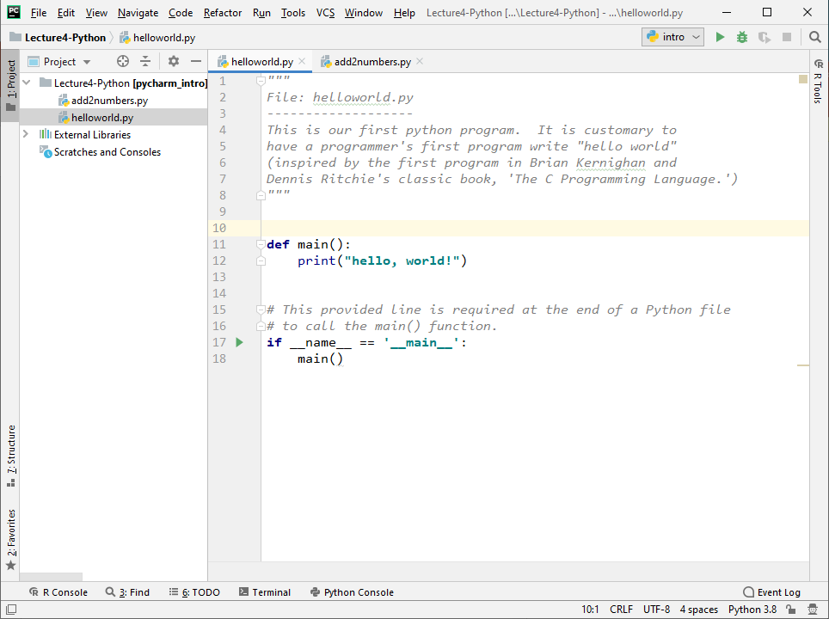
Our First Python Program

Slide 19
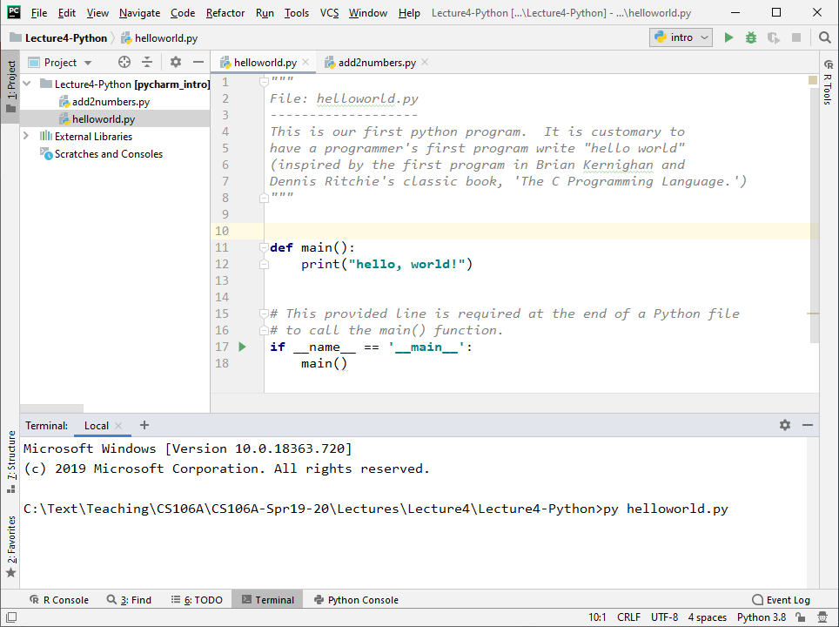
Our First Python Program
This is on a PC.
On Macs: python3 helloworld.py

Slide 20

Our First Python Program

Slide 21
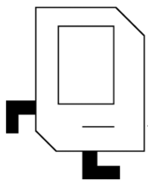
You’re now all Python programmers!
hey_that_looks_ like_what_I_ taught_them()

Slide 22
How do computers get input (data)?

Slide 23
How do computers store information (data)?

Slide 24
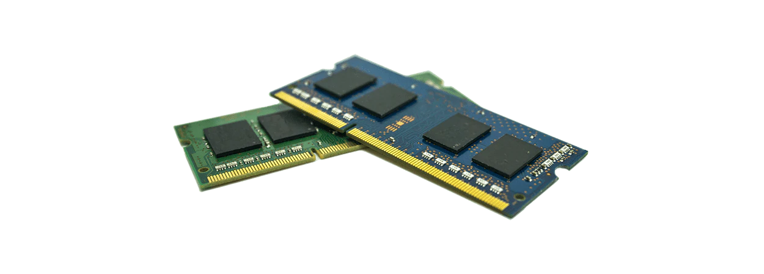
Your computer has memory!
Information is stored in your computer’s memory (RAM)

Slide 25
How do computers store information (data) in code?

Slide 26
How do computers store information (data) in code?
Variables!

Slide 27
Variable
Definition
variable
A way for code to store information by associating a value with a name

Slide 28
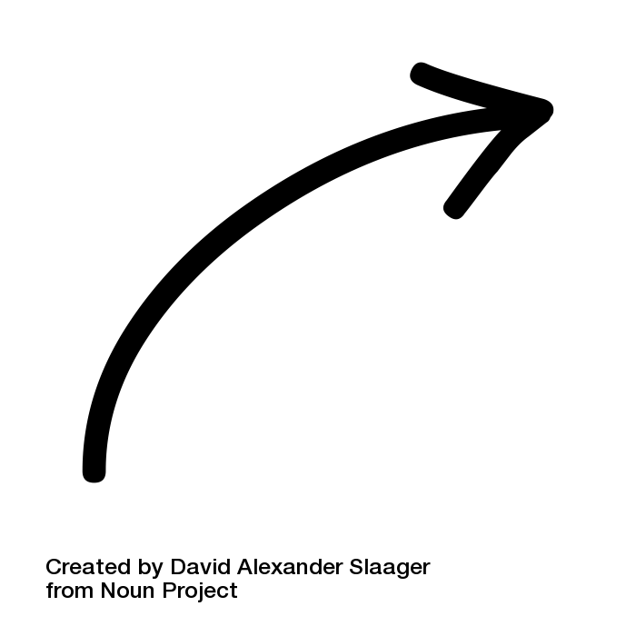
Variable
Think of them as labels for containers!
Definition
variable
A way for code to store information by associating a value with a name

Slide 29
Suitcase Analogy
When you store information in Python, it becomes a Python object
Objects come in different sizes and types (more on types later)

Slide 30
Suitcase Analogy
When you store information in Python, it becomes a Python object
Objects come in different sizes and types (more on types later)
Python objects are stored on RAM

Slide 31

Suitcase Analogy
When you store information in Python, it becomes a Python object
Objects come in different sizes and types (more on types later)
You can think about a Python object as a suitcase stored in your computer’s memory, taking up different amounts of RAM depending on what you’re storing.

Slide 32
Suitcase Analogy
You can think about a Python object as a suitcase stored in your computer’s memory.

Slide 33
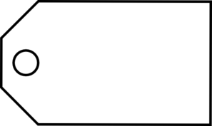
Suitcase Analogy
A variable is a luggage tag for your suitcase that gives it a name!
name

Slide 34
Variable
Variable: name that represents a value stored in the computer memory
Used to access and manipulate data stored in memory
A variable references the value it represents
Assignment statement: used to create a variable and make it reference data
General format is variable = expression
Example: age = 29
Assignment operator: the equal sign (=)

Slide 35
Variable
In assignment statement, variable receiving value must be on left side
You can only use a variable if a value is assigned to it
my_age = 18

Slide 36
Variable Naming Rules
Rules for naming variables in Python:
Variable name cannot be a Python key word
Variable name cannot contain spaces
First character must be a letter or an underscore
After first character may use letters, digits, or underscores
Variable names are case sensitive
Variable name should reflect its use
x = 10 versus my_grade = 10

Slide 37

An example
A Variable Example
Suppose you’re writing a program that keeps track of the flowers in your garden:

Slide 38
A Variable Example
Suppose you’re writing a program that keeps track of the flowers in your garden:
num_flowers = 5

Slide 39
A Variable Example
Suppose you’re writing a program that keeps track of the flowers in your garden:
num_flowers = 5
5
num_flowers

Slide 40
A Variable Example
Suppose you’re writing a program that keeps track of the flowers in your garden:
num_flowers = 5
5
num_flowers
Definition
variable assignment
The process of associating a name with a value (use the =)

Slide 41
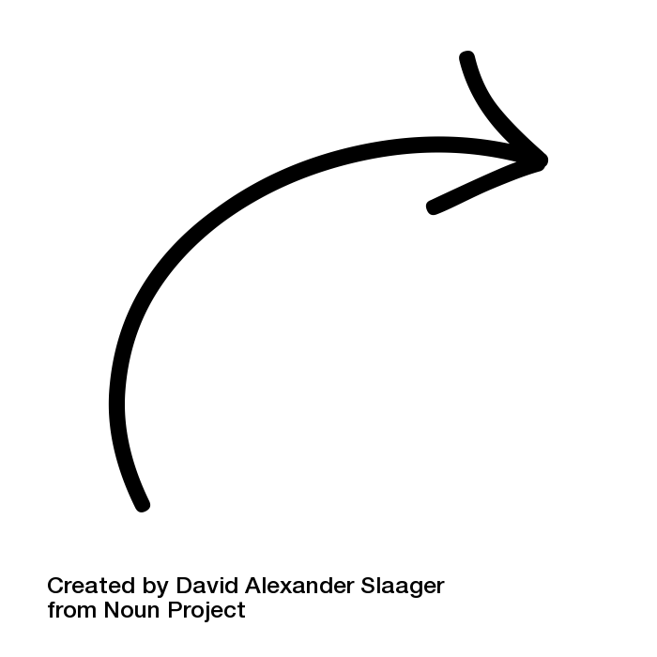
A Variable Example
Suppose you’re writing a program that keeps track of the flowers in your garden:
num_flowers = 5
5
num_flowers
Definition
i.e. attaching it to the bag
variable assignment
The process of associating a name with a value (use the =)

Slide 42
A Variable Example
Suppose you’re writing a program that keeps track of the flowers in your garden:
num_flowers = 5
5
num_flowers
variable’s name

Slide 43
A Variable Example
Suppose you’re writing a program that keeps track of the flowers in your garden:
num_flowers = 5
5
num_flowers
variable’s
value

Slide 44
A Variable Example
Suppose you’re writing a program that keeps track of the flowers in your garden:
num_flowers = 5
5
num_flowers

Slide 45
A Variable Example
Suppose you’re writing a program that keeps track of the flowers in your garden:
num_flowers = 5 num_picked = 2
5
num_flowers
2
num_picked

Slide 46
A Variable Example
Suppose you’re writing a program that keeps track of the flowers in your garden:
num_flowers = 5 num_picked = 2 num_flowers = num_flowers – num_picked

Slide 47
A Variable Example
Suppose you’re writing a program that keeps track of the flowers in your garden:
num_flowers = 5 num_picked = 2 num_flowers = num_flowers – num_picked
Think/Share: Try to predict what happens here!

Slide 48
A Variable Example
Suppose you’re writing a program that keeps track of the flowers in your garden:
num_flowers = 5 num_picked = 2 num_flowers = num_flowers – num_picked
5
num_flowers
2
num_picked
variable assignment!

Slide 49
A Variable Example
Suppose you’re writing a program that keeps track of the flowers in your garden:
num_flowers = 5 num_picked = 2 num_flowers = num_flowers – num_picked
5
num_flowers
2
num_picked
The right side of the equals sign always gets evaluated first.

Slide 50
A Variable Example
Suppose you’re writing a program that keeps track of the flowers in your garden:
num_flowers = 5 num_picked = 2 num_flowers = num_flowers – num_picked
5
num_flowers
2
variable retrieval!
num_picked

Slide 51
A Variable Example
Suppose you’re writing a program that keeps track of the flowers in your garden:
num_flowers = 5 num_picked = 2 num_flowers = num_flowers – num_picked
5
num_flowers
Definition
2
num_picked
variable retrieval
The process of getting the value associated with a name

Slide 52
A Variable Example
Suppose you’re writing a program that keeps track of the flowers in your garden:
num_flowers = 5 num_picked = 2 num_flowers = num_flowers – num_picked
5
num_flowers
2
num_picked
The right side of the equals sign always gets evaluated first.

Slide 53
A Variable Example
Suppose you’re writing a program that keeps track of the flowers in your garden:
num_flowers = 5 num_picked = 2 num_flowers = num_flowers – num_picked
5
num_flowers
5
2
2
num_picked
We get the values using variable retrieval (i.e. checking what suitcase is attached).

Slide 54
A Variable Example
Suppose you’re writing a program that keeps track of the flowers in your garden:
num_flowers = 5 num_picked = 2 num_flowers = num_flowers – num_picked
5
num_flowers
5
2
2
num_picked
Then we can evaluate the right hand side of the assignment.

Slide 55
A Variable Example
Suppose you’re writing a program that keeps track of the flowers in your garden:
num_flowers = 5 num_picked = 2 num_flowers = num_flowers – num_picked
5
num_flowers
5
2
2
num_picked
3
Then we can evaluate the right hand side of the assignment.

Slide 56
A Variable Example
Suppose you’re writing a program that keeps track of the flowers in your garden:
num_flowers = 5 num_picked = 2 num_flowers =
num_flowers
3
2
num_picked
The right side of the equals sign always gets evaluated first.

Slide 57
A Variable Example
Suppose you’re writing a program that keeps track of the flowers in your garden:
num_flowers = 5 num_picked = 2 num_flowers =
3
num_flowers
3
2
num_picked
This is a new Python object!

Slide 58
A Variable Example
Suppose you’re writing a program that keeps track of the flowers in your garden:
num_flowers = 5 num_picked = 2 num_flowers =
3
num_flowers
3
2
num_picked
Python handles all the baggage for you when you use variables.

Slide 59
How do computer get user input?

Slide 60
input function
num1 = input("Enter first number: ")
input command gets text input from the user
Prints text specified in double/single quotes
Then waits for user input
Here, user input from input is put in a variable (num1)
The user input is considered text, even if user entered a number
We'll talk more about input function later

Slide 61
Data Types

Slide 62
The suitcase analogy
When you store information in Python, it becomes a Python object
Objects come in different sizes and types
You can think about a Python object as a suitcase stored in your computer’s memory.
A variable is a luggage tag for your suitcase that gives it a name!
name

Slide 63
The suitcase analogy
When you store information in Python, it becomes a Python object
Objects come in different sizes and types
name

Slide 64
The suitcase analogy
When you store information in Python, it becomes a Python object
Objects come in different sizes and types
num_flowers = 5
5
num_flowers

Slide 65
The suitcase analogy
When you store information in Python, it becomes a Python object
Objects come in different sizes and types
num_flowers = 5
5 is an integer
5
num_flowers

Slide 66
The suitcase analogy
When you store information in Python, it becomes a Python object
Objects come in different sizes and types
num_flowers = 5
5 is an integer
5
int
num_flowers

Slide 67
The suitcase analogy
When you store information in Python, it becomes a Python object
Objects come in different sizes and types
num_flowers = 5.0
5.0 is a float (has decimals)
5.0
float
num_flowers

Slide 68
All Python objects have a type!
Types
Python automatically figures out the type based on the value
Variables are “dynamically-typed”: you don’t specify the type of the Python object they point to

Slide 69
All Python objects have a type!
Types
Called “doubles” in some other languages
Integers - numbers with no decimals
num_flowers = 5
Floats - numbers with decimals
fraction = 0.2
Booleans - true or false
is_raining_today = True
Strings - collection of characters
myName = ‘Ayca’
Represented by bool

Slide 70

Suppose you’re programming for a doctor’s office...
Types
What type would you use to store each of the following?
Think/Share

Slide 71
Suppose you’re programming for a doctor’s office...
Types
What type would you use to store each of the following?
The patient’s weight
The number of days since the patient’s last visit
The patient’s temperature
If the patient has had their flu shot
The patient’s number of children

Slide 72
Suppose you’re programming for a doctor’s office...
Types
What type would you use to store each of the following?
The patient’s weight → float
The number of days since the patient’s last visit
The patient’s temperature
If the patient has had their flu shot
The patient’s number of children

Slide 73
Suppose you’re programming for a doctor’s office...
Types
What type would you use to store each of the following?
The patient’s weight → float
The number of days since the patient’s last visit → integer
The patient’s temperature
If the patient has had their flu shot
The patient’s number of children

Slide 74
Suppose you’re programming for a doctor’s office...
Types
What type would you use to store each of the following?
The patient’s weight → float
The number of days since the patient’s last visit → integer
The patient’s temperature → float
If the patient has had their flu shot
The patient’s number of children

Slide 75
Suppose you’re programming for a doctor’s office...
Types
What type would you use to store each of the following?
The patient’s weight → float
The number of days since the patient’s last visit → integer
The patient’s temperature → float
If the patient has had their flu shot → boolean
The patient’s number of children

Slide 76
Suppose you’re programming for a doctor’s office...
Types
What type would you use to store each of the following?
The patient’s weight → float
The number of days since the patient’s last visit → integer
The patient’s temperature → float
If the patient has had their flu shot → boolean
The patient’s number of children → integer

Slide 77
Explicit Type Conversion
num1 = 5 num2 = 2
num3 = 1.9
Use float(value) to create new real-valued number
float(num1) = 5.0 (float)
Note that num1 is not changed. We created a new value.
num1 + float(num2) = 7.0 (float)
num1 + num2 = 7 (int)
Use int(value) to create a new integer-valued number (truncating anything after decimal)
int(num3) = 1 (int)
int(-2.7) = -2 (int)

Slide 78
Explicit Type Conversion
num1 = 5 num2 = 2
num3 = 1.9
Use str(value) to create new text out number
float(num1) = ‘5’ (String)
float(num2) = ‘2’ (String)
float(num3) = ‘1.9’. (String)

Slide 79
Ready for another example?

Slide 80
Another Program
def main(): print("This program adds two numbers.")

Slide 81
Recall, Our Program
def main(): print("This program adds two numbers.")
This program adds two numbers.
print command is displaying a string

Slide 82
Recall, Our Program
def main(): print("This program adds two numbers.") num1 = input("Enter first number: ")
num1
"9"
This program adds two numbers.
Enter first number: 9
input command gives you back a string
Even if the user types in a number

Slide 83
Show Me The Luggage!
input command gives you back a string
num1 = input("Enter first number: ")
We create an integer version of num1
num1 = int(num1)
Create a new suitcase that has int version of num1
Then assign the tag num1 to that piece of luggage
num1 = int(num1)
num1
"9"
string
int
num1
9

Slide 84
Recall, Our Program
def main(): print("This program adds two numbers.") num1 = input("Enter first number: ") num1 = int(num1)
num1
"9"
This program adds two numbers.
Enter first number: 9
Create int version of string and assign it back to num1

Slide 85
Recall, Our Program
def main(): print("This program adds two numbers.") num1 = input("Enter first number: ") num1 = int(num1) num2 = input("Enter second number: “)
"17"
num1
9
num2
This program adds two numbers.
Enter first number: 9
Enter second number:

Slide 86
Recall, Our Program
def main(): print("This program adds two numbers.") num1 = input("Enter first number: ") num1 = int(num1) num2 = input("Enter second number: ") num2 = int(num2)
17
num1
9
num2
This program adds two numbers.
Enter first number: 9
Enter second number: 17

Slide 87
Recall, Our Program
def main(): print("This program adds two numbers.") num1 = input("Enter first number: ") num1 = int(num1) num2 = input("Enter second number: ") num2 = int(num2) total = num1 + num2
17
num1
9
num2
total
26
This program adds two numbers.
Enter first number: 9
Enter second number: 17

Slide 88
Recall, Our Program
def main(): print("This program adds two numbers.") num1 = input("Enter first number: ") num1 = int(num1) num2 = input("Enter second number: ") num2 = int(num2) total = num1 + num2 print("The total is " + str(total) + “.")
17
num1
9
num2
total
26
This program adds two numbers.
Enter first number: 9
Enter second number: 17
The total is 26.

Slide 89
What's Going on With print
Adding strings in print command
print("The total is " + str(total) + ".")
The + operator concatenates strings together
str1 = "hi"
str2 = " "
str3 = "there"
str4 = str1 + str2 + str3
total is integer, so we need to create a string version
str(total)
String version of total is a new value that is concatenated to produce final string that is printed
Original variable total is still an int

Slide 90
Recall, Our Program
def main(): print("This program adds two numbers.") num1 = input("Enter first number: ") num1 = int(num1) num2 = input("Enter second number: ") num2 = int(num2) total = num1 + num2 print("The total is " + str(total) + ".")
17
num1
9
num2
total
26
This program adds two numbers.
Enter first number: 9
Enter second number: 17
The total is 26.

Slide 91
Side note about print
You can print numbers by themselves directly
Only need to create string version of numbers when printing other text (strings) with them
def main(): x = 10 y = 3.5 print(x) print(y) print("x = " + str(x))
10
3.5
x = 10

Slide 92
You just wrote your first
Python program and learned
about variables!

Slide 93
How do we process the information that we’ve stored?

Slide 94
Expressions

Slide 95
Recall: expressions
In Karel, we only saw “boolean expressions” that evaluate to true/false
In Python, expressions can evaluate to any type!
The computer evaluates expressions to a single value
We use operators to combine literals and/or variables into expressions

Slide 96
Recall: expressions
In Karel, we only saw “boolean expressions” that evaluate to true/false
In Python, expressions can evaluate to any type!
The computer evaluates expressions to a single value.
We use operators to combine literals and/or variables into expressions
Literals are Python objects written directly in code, e.g. the 5 in
num_flowers = 5

Slide 97
Performing Calculations
Math expression: performs calculation and gives a value
Math operator: built-in tool for performing calculation
Operands: values surrounding operator
Variables can be used as operands
Resulting value typically assigned to variable

Slide 98
Arithmetic operators
Performing Calculations
* Multiplication
/ Division
// Integer division
% Modulus (remainder)
+ Addition
- Subtraction
** Exponentiation
Two types of division:
/ operator performs floating point division
// operator performs integer division
Positive results truncated, negative rounded away from zero

Slide 99
Arithmetic Operators
num1 = 5 num2 = 2
num3
7
3
10
2.5
2
1
25
-5
Operations on numerical types (int and float)
Operators
+ "addition" Ex.: num3 = num1 + num2
- "subtraction" Ex.: num3 = num1 - num2
* "multiplication" Ex.: num3 = num1 * num2
/ "division" Ex.: num3 = num1 / num2
// "integer division" Ex.: num3 = num1 // num2
% "remainder" Ex.: num3 = num1 % num2
** "exponentiation" Ex.: num3 = num1 ** num2
- "negation" (unary) Ex.: num3 = -num1

Slide 100
Arithmetic operators
Performing Calculations
Operator | Precedence
() | 1
*, /, //, % | 2
+, - | 3
* Multiplication
/ Division
// Integer division
% Modulus (remainder)
+ Addition
- Subtraction

Slide 101
Arithmetic operators
Performing Calculations
Operator | Precedence
() | 1
*, /, //, % | 2
+, - | 3
* Multiplication
/ Division
// Integer division
% Modulus (remainder)
+ Addition
- Subtraction
This is your “order of operations” for Python!

Slide 102
Arithmetic operators
Performing Calculations
Operator | Precedence
() | 1
*, /, //, % | 2
+, - | 3
* Multiplication
/ Division
// Integer division
% Modulus (remainder)
+ Addition
- Subtraction
Ties within rows are broken by going from left to right

Slide 103
Let’s do some examples!
Performing Calculations
Operator | Precedence
() | 1
*, /, //, % | 2
+, - | 3
4 + 2 * 3
5 + 1 / 2 - 4
15 / 2.0 + 6
5 + 1 / (2 - 4)
5 + 1 // (2 - 4)
1 * 2 + 3 * 5 % 4
Let’s all think about it

Slide 104
Let’s do some examples!
Performing Calculations
Operator | Precedence
() | 1
*, /, //, % | 2
+, - | 3
4 + 2 * 3
5 + 1 / 2 - 4
15 / 2.0 + 6
5 + 1 / (2 - 4)
5 + 1 // (2 - 4)
1 * 2 + 3 * 5 % 4
[demo]

Slide 105
Let’s do some examples!
Performing Calculations
Operator | Precedence
() | 1
*, /, //, % | 2
+, - | 3
4 + 2 * 3 → 10
5 + 1 / 2 - 4 → 1.5
15 / 2.0 + 6 → 13.5
5 + 1 / (2 - 4) → 4.5
5 + 1 // (2 - 4) → 4
1 * 2 + 3 * 5 % 4 → 5
[demo]

Slide 106
Let’s do some examples!
Performing Calculations
4 + 2 * 3 → 10
5 + 1 / 2 - 4 → 1.5
15 / 2.0 + 6 → 13.5
5 + 1 / (2 - 4) → 4.5
5 + 1 // (2 - 4) → 4
1 * 2 + 3 * 5 % 4 → 5
NOTE: Any of the literals can also be replaced with variables that are associated with the same value

Slide 107
Let’s do some examples!
Performing Calculations
4 + 2 * 3 → 10
5 + 1 / 2 - 4 → 1.5
15 / 2.0 + 6 → 13.5
5 + 1 / (2 - 4) → 4.5
5 + 1 // (2 - 4) → 4
1 * 2 + 3 * 5 % 4 → 5
For example:
x = 2
4 + x * 3
This evaluates to 10, just like our first example expression!

Slide 108
Expression Shorthands
num1 = 5 num2 = 2
num3 = 1.9
num1 = num1 + 1 same as num1 += 1
num2 = num2 - 4 same as num2 -= 4
num3 = num3 * 2 same as num3 *= 2
num1 = num1 / 2 same as num1 /= 2
Generally:
variable = variable operator (expression)
is same as:
variable operator= expression

Slide 109
Implicit Type Conversion
num1 = 5 num2 = 2
num3 = 1.9
Operations on two ints (except /) that would result in an integer value are of type int
num1 + 7 = 12 (int)
Dividing (/) two ints results in a float, even if result is a round number (Ex.: 6 / 2 = 3.0)
If either (or both) of operands are float, the result is a float
num3 + 1 = 2.9 (float)
Exponentiation depends on the result:
num2 ** 3 = 8 (int)
2 ** -1 = 0.5 (float)

Slide 110
How should we store information if it is known and never changes?

Slide 111
How should we store information if it is known and never changes?
Constants!

Slide 112
Constants are like variables that don’t change
Constants
Constants give descriptive names to literals
Style note
constants
Use constants with descriptive names instead of literals directly in your code.

Slide 113
Constants are like variables that don’t change
Constants
Constants give descriptive names to literals
Use all capital letters and snake_case when naming constants
Style note
constant names
Use all capital letters and snake_case, for example MY_CONSTANT = 500.

Slide 114
Constants are like variables that don’t change
Constants
Constants give descriptive names to literals
Use all capital letters and snake_case when naming constants
Constants are usually assigned outside functions and at the top of your program file (underneath the imports)

Slide 115
Example of Using Constants
""" File: constants.py ------------------ An example program with constants """ INCHES_IN_FOOT = 12 def main(): feet = float(input("Enter number of feet: ")) inches = feet * INCHES_IN_FOOT print("That is " + str(inches) + " inches!") # This provided line is required at the end of a Python file # to call the main() function. if __name__ == '__main__': main()

Slide 116
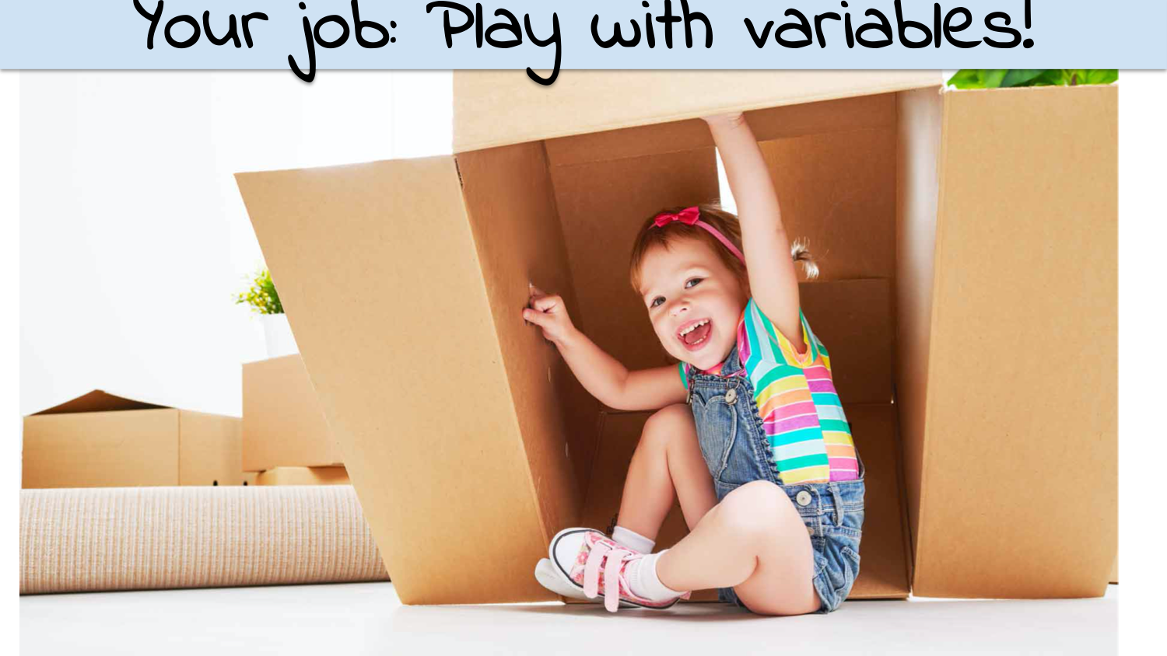

Implicit Type Conversion
num1 = 5 num2 = 2
num3 = 1.9
Operations on two ints (except /) that would result in an integer value are of type int
num1 + 7 = 12 (int)
Dividing (/) two ints results in a float, even if result is a round number (Ex.: 6 / 2 = 3.0)
If either (or both) of operands are float, the result is a float
num3 + 1 = 2.9 (float)
Exponentiation depends on the result:
num2 ** 3 = 8 (int)
2 ** -1 = 0.5 (float)
Caption

